Slide 1
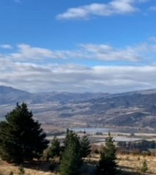
Rural Palliative Care CNS
Gayle McCormack MnRGON

Slide 2
GOALS
Understand
Understand Development of Palliative Care CNS Role in Rural Palliative Care and its relation to the Palliative Care Strategy.
Understand
Understand relationship between Rural Palliative Care CNS and Hospice
Identify
Identify Geographical region Palliative Care CNS covers and services available
Discuss
Briefly discuss an initiative developed by District Nursing to provide a safer system of Syringe Driver Medication and prn Medication provision
Discuss
Discuss 2 case studies to highlight how the role improves equity of care.

Slide 3
ROLE DEVELOPEMENT
Role developed in relation to the NZ Palliative Care strategy 2001
Factors affecting Palliative Care in Central Otago was the delivery of Palliative Care being poorly integrated into Primary and Secondary Care, Lack of Co-ordination causing service Variabillity and funding gaps.
The Role was developed to reduce disparities in health status , ensure accessabile and appropriate services for people from lower socio-economic groups and ensure culturally appropriate care for Maori and Pacific Island people as well as other ethnicities.
The role aligns with the national model for palliative care which is: “ to provide a seamless service for patients as they move between settings in the community, the hospital inpatient system, hospice inpatient units, and ARC “.

Slide 4
Aims Of The Rural Palliative CNS Role
Improve access to Palliative Care for patients in the rural community in primary and secondary health
Provide advanced clinical advice / support regarding complex symptom management underpinned by Te Ara Whakapiri Guidelines
Prescribing medications relevant to palliative care when appropriate.
Physical and Emotional support to the patient / family /whanau
Education to the patient / family/ whanau regarding medications/ caring for a dying person, manual handling / wound management/ Pressure area care.
Assist with discharge planning and advanced planning as requested
Providing education and support to staff within COHSL
Liaising with other professionals involved in the patients care i.e. General Practitioner, District Nurses, Specialist services, NGO’s such as the Cancer Society or Hospice. Providing negotiation between primary and secondary care.
Utilising multiple modes of communication to ensure everyone involved in the patients care is kept informed and up to date.

Slide 5
Palliative Care CNS Role
Rural communities’ health needs are often under-served, particularly in relation to accessing health services, especially for remote communities and rural Māori. With 19 percent of New Zealand population living in rural areas and of that 19% a higher percentage of Māori living in more rurally isolated areas. Access to timely, quality Palliative care is challenging.
Palliative care CNS serves the rural Central Otago community actioning two of the five rural health strategy priorities. By providing quality care closer to home and having a valued and flexible workforce.
The PCCNS role enables equitable care to be delivered to Palliative patients and therefore reduces avoidable hospital admissions.
This role is very unique as the PCCNS works across both primary and secondary sectors often acting as the liaison or negotiator between services. The role is multi-faceted and requires the ability to work autonomously, collegially and honestly while utilizing anatomy and physiology, pharmacology and clinical assessment skills as well as advanced palliative care knowledge.
Referrals are received via the District Nursing Service from GPs, Hospice and Specialists or Hospital Services.
The CNS attends MDT meetings in the Dunstan Hospital Ward and with the Hospice team to ensure facilitation of co-ordinated palliative care.

Slide 6
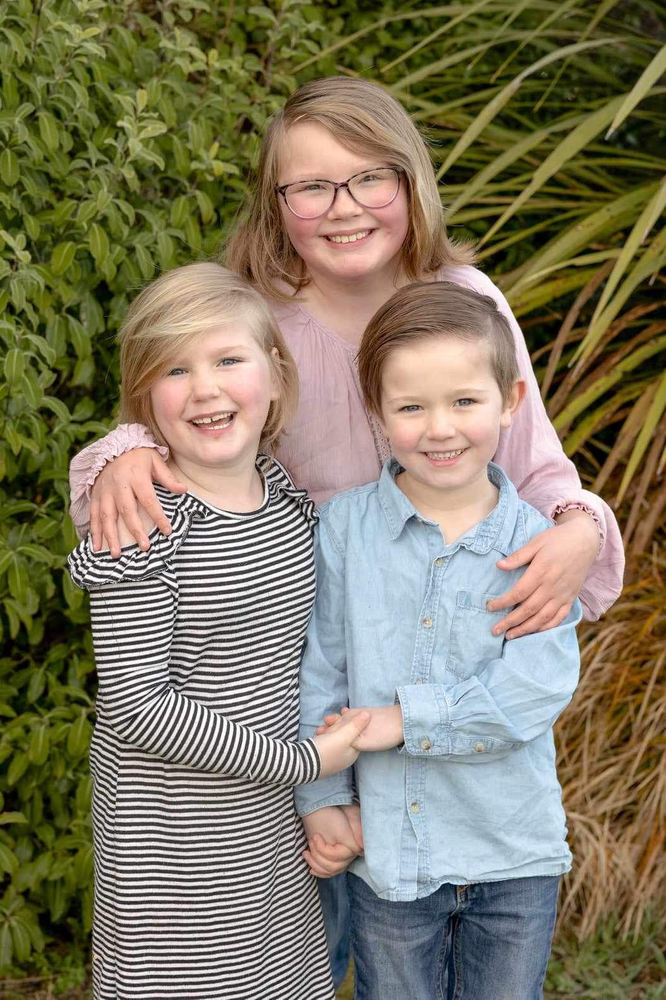
My Background
Graduated RGON 1990
Surgical Nurse for 10 years
District Nursing in Kenepuru and Kapiti (Wellington) for 9 years.
Worked as a Palliative Care Co-ordinator for Mary Potter Hospice for 3 years
Moved to Dunedin and worked in the Hospital Palliative Care Advisory Service for 3years as a PCNS before moving to Central Otago and taking up this role.
Master of Nursing Degree 2018
Nurse Prescriber 2021
Mother of 2 adult girls, 3 grandchildren and 2 Furkids

Slide 7
Who can Be Seen?

Slide 8
Geographical area
Population of 26,000 which has increased by 5,000 since I began.
9,968 km2

Slide 9
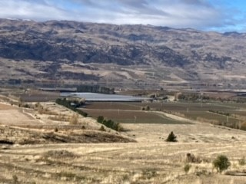
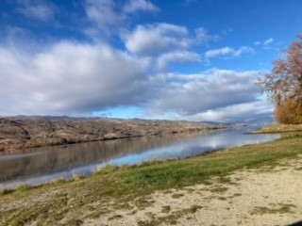
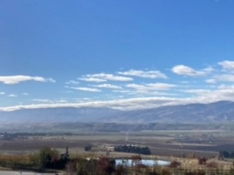

Slide 10
Palliative SERVICES AVAILABLE IN Central Otago
Palliative Care CNS District Nursing 72 hours during a fortnight covering the geographical area.
District Nursing available 7 days per week 0800 -1630hrs
Otago Hospice Monday – Friday 0830 -1700hrs with 24hour phone service 0800 number
No physical afterhours service for palliative patients after 1700hrs
Hospice inpatient unit is in Dunedin (3-4hrs drive away)
1 Palliative Care Bed in Rural Hospital (Dunstan) and 1 dedicated Palliative Care Bed available in HLC facility in Wanaka
No Emergency Department
Afterhours GPs only 1 practice available in each area over a weekend / public Holiday. Patients have to see a GP to be admitted to Hospital unit only available until 2100hrs weekdays
St Johns Ambulance available 24hours.
No equipment stores available afterhours or on weekends.

Slide 11
INITIATIVE IN CENTRAL OTAGO
3 Pharmacies approached and asked about drawing up of medications.
Wanaka Pharmacist was already providing this to Wanaka palliative patients for Syringe Drivers and prn medications
Discussed with Wanaka pharmacist the process for moving this to the other 2 pharmacies and he agreed to assist in facilitating the other pharmacies.
Other 2 pharmacies had to receive appropriate training and buy their own sterile drawing-up box and equipment but are paid by pharmac to provide the service.
GPs had to change their prescribing practice slightly and only send Syringe Driver Prescriptions to the designated pharmacies
District Nurses can collect the drawn-up medications for family if a family member is unable to.
Buccal prn medications are also used wherever possible now.

Slide 12
BENEFITS OF PRE-DRAWN sd/PRN s/cut MEDICATIONS
Medications are drawn-up aseptically in a sterile environment with double checking or prescription and medications.
Less burden on the family when learning how to give a prn s/cut medication
Less risk of error for the family drawing up the medication
Decreased risk for the District Nurses when checking the medications
Less medications held in the home for the patient and amounts being checked daily
If there was a possible incident where a patients access was cut off a family member could be talked through (on a phone) how to change a SD as there would be syringes available in the home.
Syringes last 3 days drawn-up so decreased time in the home for the district nurse during pandemic and afterwards.

Slide 13
Cons of predrawn medications
Pharmacies are only open until 1pm on Saturdays in any of the towns and prefer not to have to draw-up medications.
GP or prescriber needs to have the prescriptions to the pharmacy as early as possible in the day to enable the pharmacy time to draw everything up and ensure they have prescribed adequate amount of ampoules etc.
Difficult to change a Syringe Driver prescription on a weekend if the patients needs have changed.
District Nurse has to calculate how many prn medications will be needed for the weekend and ensure there are adequate available.
District Nurse or Hospice nurse provides the education for families to administer prn medications and inserts the subcutaneous needles into the patients.

Slide 15
Case Review
JOHN 55yr old beneficiary Maori
Severe COPD with type II respiratory failure / FEV1 0.5L
Admission in Sep 2016 in extremis. No IV access available. Did not tolerate BiPAP due to significant air trapping.
On home O2 usually 0.5L/min – 3 monthly assessment
Opioid and benzo dependence; on methadone programme
Extremely difficult IV access
Hep C positive
Previous traumatic pneumothorax 2007

Slide 16
medications
Diazepam 5 to 20mg daily, Roxithromycin 300mg Daily
Ensure Vanilla
Flixotide 2 puffs bd, Salbutamol up to 4 puffs daily
Ultibro breezehaler 1 cap daily
Hydrocortisone 1% apply twice daily, Oxygen 0.5L/min 16hours per day or longer
Methadone 2mg/ml oral solution, 130mg daily
Morphine 10mg/mL oral liquid 6ml 20-30 mins before activity up to 3 times a day
Nil Allergies

Slide 17
SOCIAL:
Lived with “friend” in 2 bedroom rented flat who also has drug dependency issues and 2 cats. Small group of friends.
Mother and brother live in Dunedin, Son in Wanaka.
Caregivers withdrawn due to friends behaviour and animosity.
Uruwhenua supporting John
EMOTIONAL:
John is aware that he will die of his disease but meanwhile trying to live life to the fullest.
Has an ACP and preference is to die at home but knows this might not be an option so second choice is Dunstan. Agreeable to having NIV but no escalation to intensive care etc.
SPIRITUAL: John does not practice a religion but enjoys music and socialisation.

Slide 18
MAIN ISSUES:
PCNS convinced GP to px morphine elixir for SOB and Midazolam nasal spray given previous addictions.
Ongoing issues : Frequent Exacerbation of COPD with lengthened antibiotic use.
-Disliked prednisone as it keeps him awake.
Having to go to pharmacy for Methadone on a daily basis.
Using home oxygen
Loss of licence – was able to hire a mobility scooter from community organization
Friend was also on CADS programme so trust issues with drugs in the home
Friend also had her own health concerns so not able to be a carer.
Difficulty gaining assistance in the home due to safety issues with the friend /flatmate

Slide 19
MANAGEMENT:
Initially GP would only prescribe 2.5mg morphine elixir prn QID. No Midazolam available.
Regular PCNS visits to monitor condition and liase with GP, collect samples and arrange medications
Following a rough winter and ongoing presentations with exacerbation able to convince GP to increase the morphine dose but only when Hospice became involved.
Hospice were able to have Midazolam nasal spray charted
CADS eventually agreed to assist in reducing number of takeaway doses of Methadone and enabling patient to collect 7 days at a time.
Delivery available from pharmacy following advocation from PCNS
Regular sputum samples pre and post antibiotics to ensure infection is completely gone. Ongoing management with prednisone and monitoring to ensure compliance.
Home visits regularly by PCNS and Hospice with follow-up post each admission to hospital which was only 2 in 12months
Ambulance plan with ACP available in the home

Slide 20
Last days of life
Admitted to Dunstan in Type 1 Respiratory Failure on a very cold winters day
Bipap trialled but with very little success
After 24hours IV Antibiotics and Bipap in HDU it was agreed John was dying so he was moved to a side room and his “friend”was able to visit as much as she could and his family arrived from Dunedin.
He was commenced on the Last Days of Life Pathway or Te Ara Whakapiri and placed on a Syringe Driver with methadone and midazolam as well as prn morphine and midazolam available.
John passed away peacefully with family present at Dunstan Hospital.

Slide 22
Case study 2
87 Year old Maori gentleman – Known as Don
Widower with large extended family
Living 25minutes away from rural hospital
Wishing to remain at home for EOLC
Decided to cease medications once discharged home from hospital
1 daughter an RN in Australia came home to stay
Living in house with Disabled brother as the home was already adapted for accessabillity.
Family Cared for him in a lazy boy chair as he refused to use a bed.

Slide 23
CASE STUDY 2
Primary Diagnosis
· Rehabilitation following prosthetic joint washout for wound dehiscence
Secondary Diagnoses
· Comorbidity
· Hypercalcaemia, likely due to dehydration from diuresis
· Heart failure. LVEF 45 to 50%
· Thyroid mass, ?significance
· Mild vitamin D defiency
· Rectal thickening, ?significance – Likely tumour
· Cholestatic LFT derangement with biochemical jaundice. No evidence of structural abnormality on CT
imaging
· Growth of Stenotrophomonas maltophilia from sputum, ?significance.

Slide 24
Management
2 weeks after ceasing oral medications began to deteriorate.
PCNS and CC OCH visited together to meet with the patient and whanau.
Assessment completed and agreed Don was deteriorating
IDC started draining haematuria but Don declined having antibiotics so PCNS supported with irrigation and equipment.
Utilizing commode chair and pull-ups for BA.
Reviewed by Hospice Doctor and GP agreed to continue with current medications.
Morphine 2.5-5mg sublingually charted, with midazolam nasal spray and haloperidol1- 2mg sublingual for increased confusion. RN daughter was given charge of this to administer.
Family providing personal cares in the lazy boy chair and roho segments placed on lazyboy for pressure area care.

Slide 25
End OF Life Care
Don became moribund and difficult to give sublingual medications to so a subcutaneous line was placed and his daughter shown how to administer s/cut morphine and midazolam prn as she was unfamiliar with giving medication this route. PRNS were pre-drawn by the pharmacy.
A Syringe Driver was commenced once a baseline of what he was using was established as he was requiring a small dose of morphine and midazolam inconsultation with OCH and GP
Dons family rallied around and had a roster set-up for caring for him and ensuring he wasn’t alone at anytime in his last days of life, providing all personal cares.
PCNS and Hospice CC visited jointly and separately daily and sometimes twice daily to provide continued assessment, support and guidance to the family.
GP provided prescriptions for the medications and visited the home once in Dons last week of life.
Don died peacefully at home with his family present.

Slide 26
What is the most important thing in the world?
It is people! It is people! It is people!

Slide 27
Questions?

Slide 28
REFERENCES
The New Zealand Palliative Care Strategy 2001 moh.govt.nz
Rural Health Care Strategy 2023 moh.govt.nz
Te Ara Whakapiri 2017 Health.govt.nz

